Slide 1
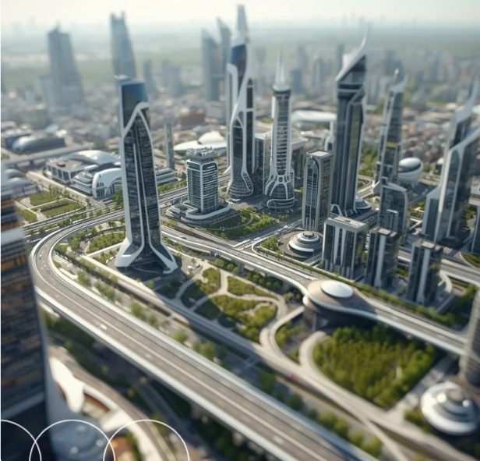
IOT AND SMART CITIES
Building a Connected Future
Presented By :
CSC-25F-603 Bushra jan
CSC-25F-617 Haroon Waleed
CSC-25F-634 Sadia Sohail
CSC-25F-629 Atif Khan
CSC-25F-602 Tuba Jan

Slide 2



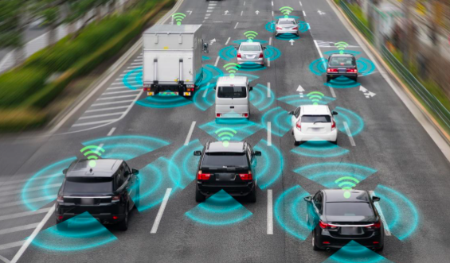
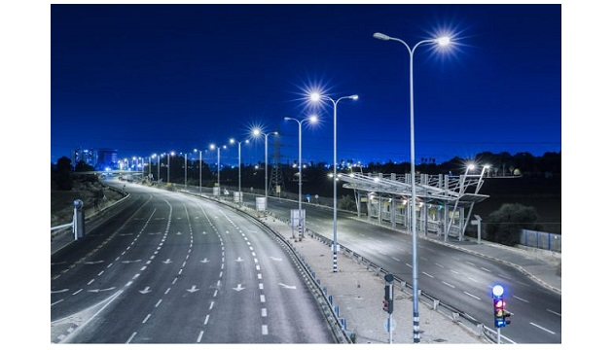

Internet of Things (IoT)
Internet of Things (IoT) means everyday objects connected to the internet. They can collect and share data automatically. This helps make tasks easier, faster, and smarter.
Barcelona uses smart street lights with IoT technology. The lights have sensors that detect people and traffic. They automatically become brighter or dimmer based on movement.

Slide 3

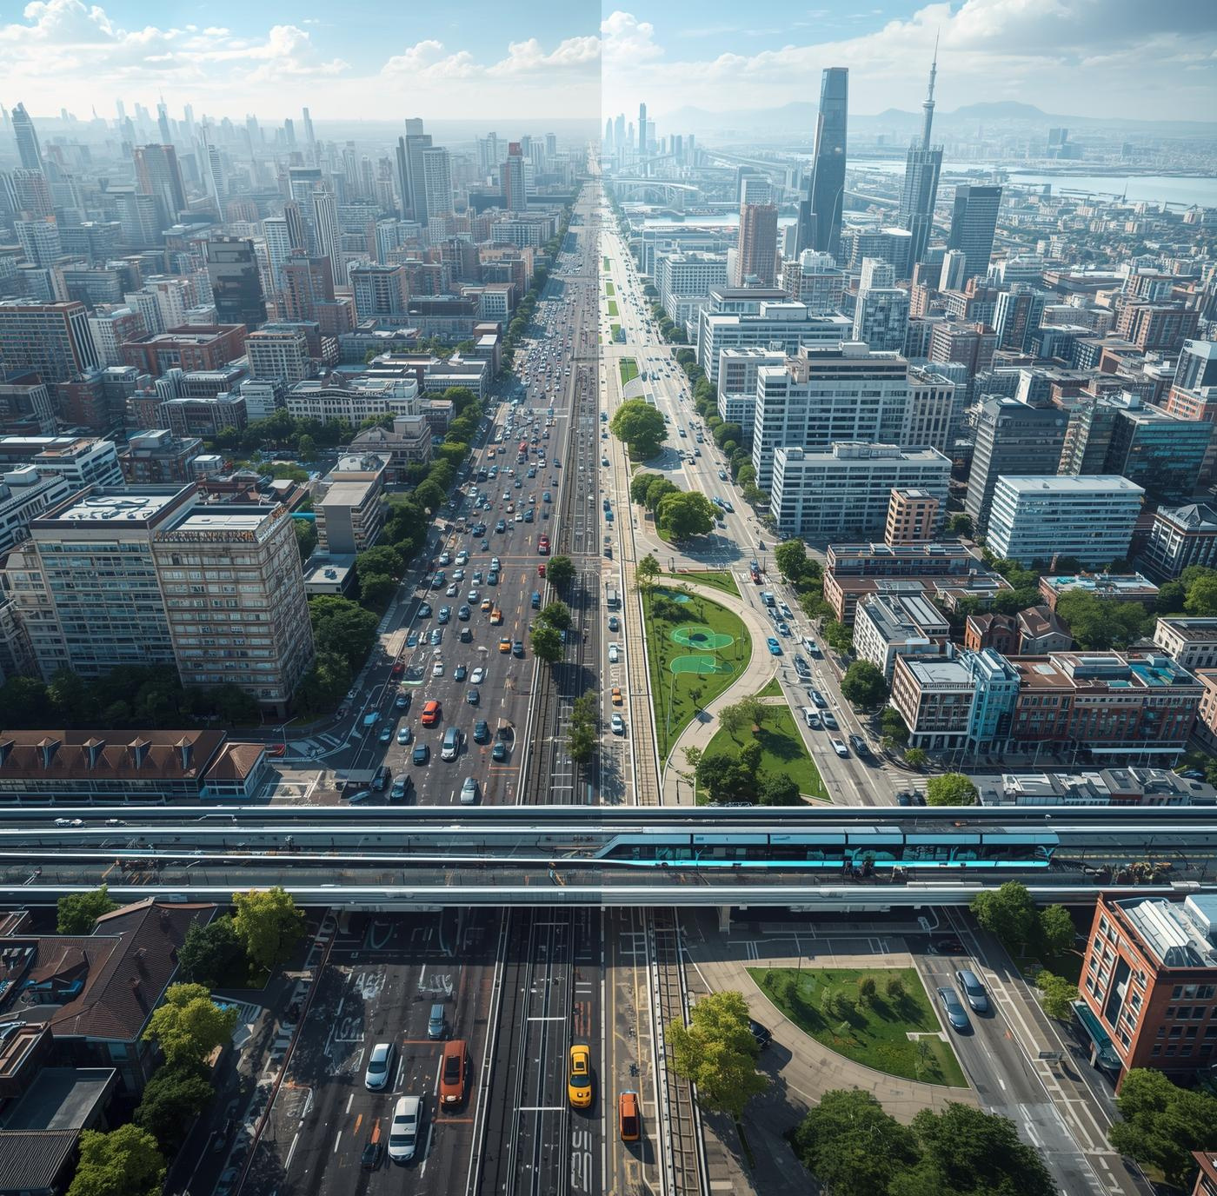

What Are Smart Cities?
Smart cities use modern technology and real-time data to make life easier for people. They improve important services like transportation, energy, and public safety. With these smart systems, cities become more efficient, more sustainable, and more connected for everyone.
Understanding the concept of smart urban areas

Slide 4



Smart vs Traditional Cities With IOT
Understanding the Differences
Traditional cities use manual work and slow systems, so daily tasks take more time. They do not have much technology, which makes management difficult. Smart cities use IoT, sensors, and real-time data to handle things automatically.
They manage traffic, energy, and safety in a better and faster way. Because of this, smart cities are more organized, quick, and helpful for people.
page 06

Slide 5
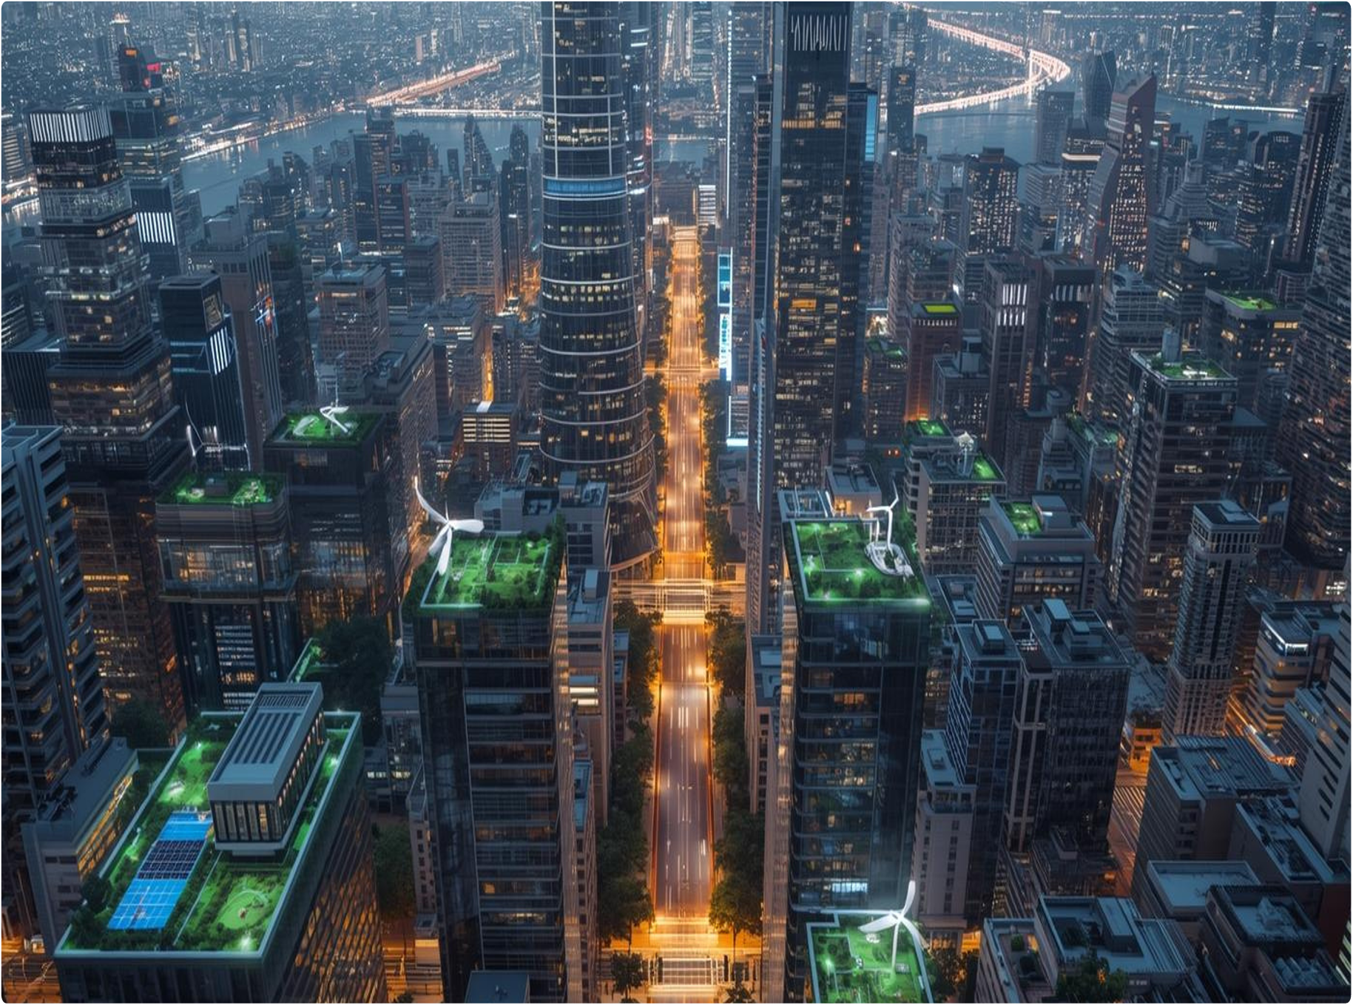

Making Our City Smart With IOT
Using IoT and digital services is very important for improving cities. They help make urban areas more efficient and better connected.
Technology Use
Traffic Management
Smart Education
Healthcare Solutions
Safety & Security (Gas & Water Leak Detection)
Role of Smart Agriculture
Waste Management
Infrastructure
Citizen Convenience (Water Management , Air Pollution Control)
Public Safety

Slide 6
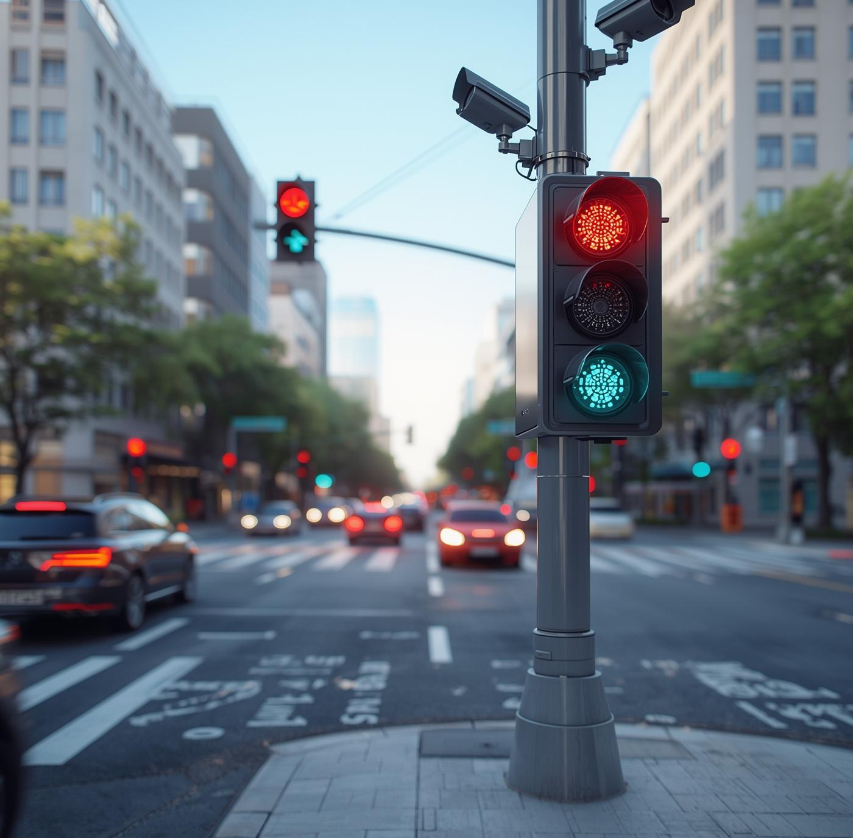
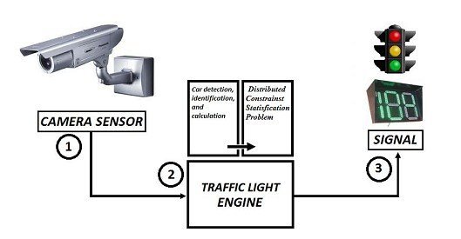

Smart Traffic System with IOT
Smart traffic systems utilize real-time monitoring to optimize flow, reducing congestion and enhancing urban mobility.

Slide 7
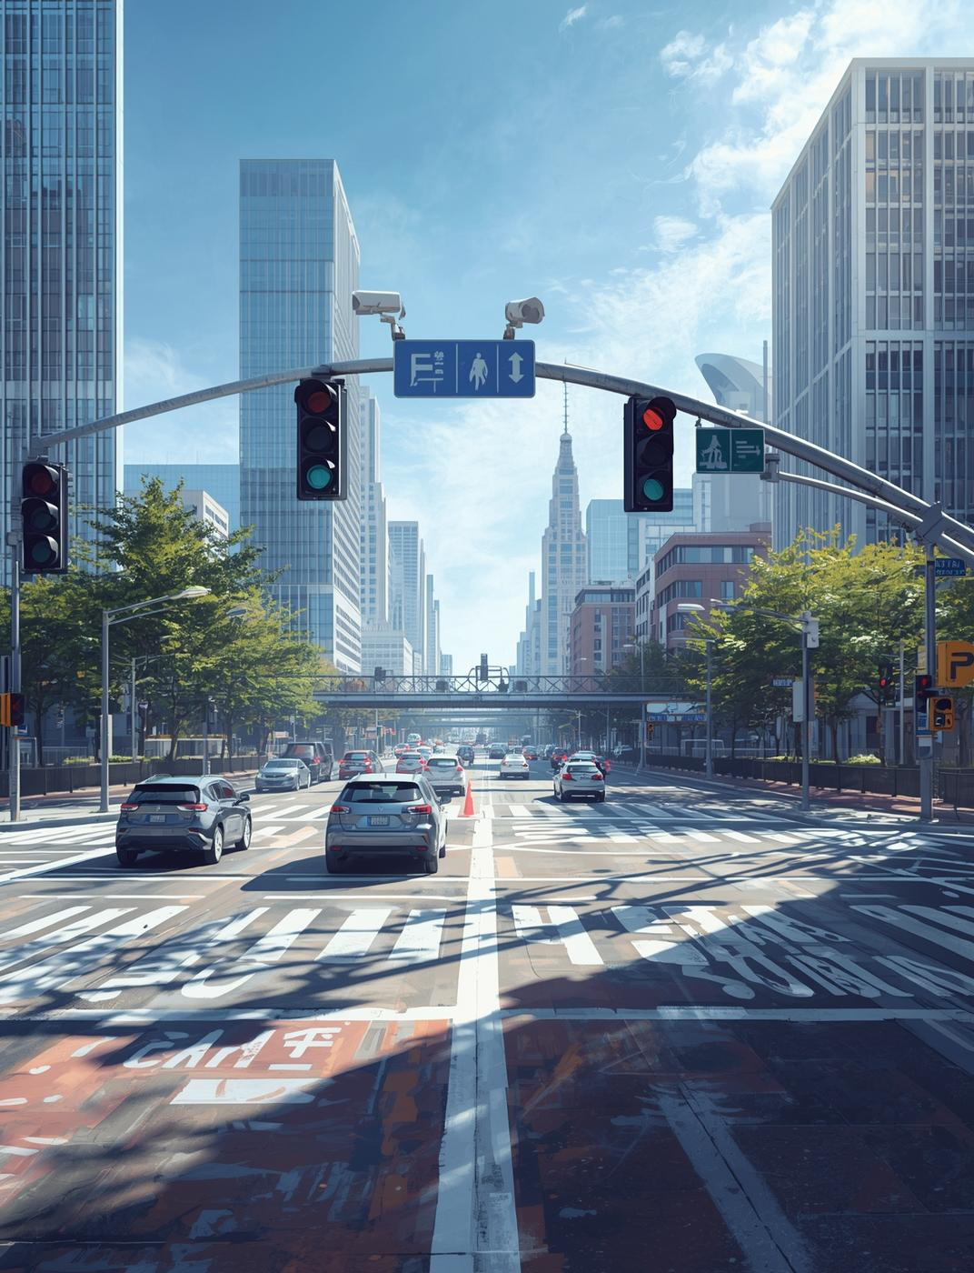
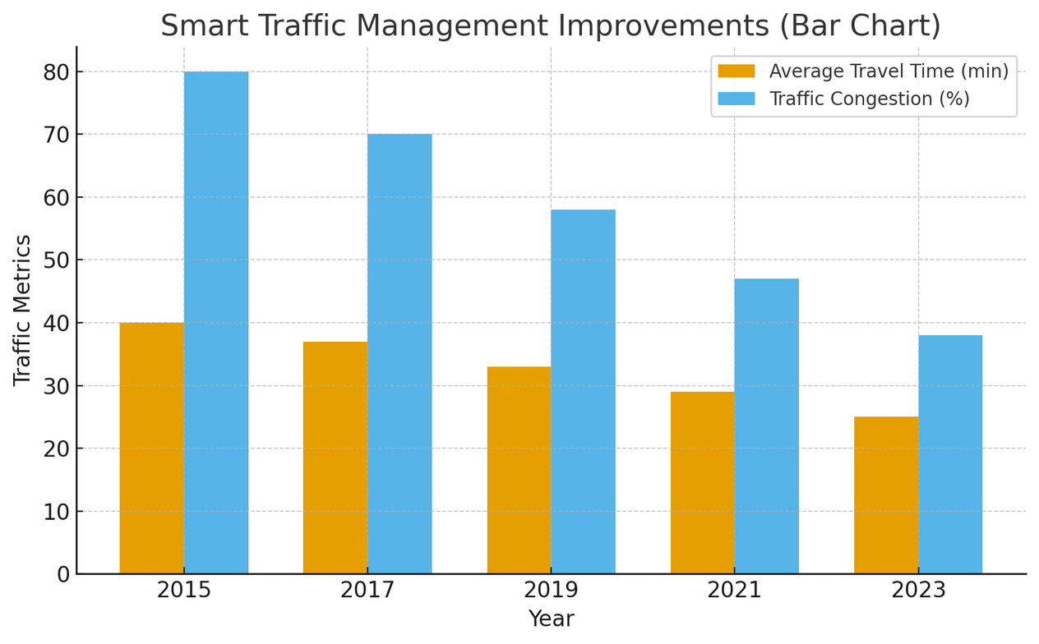
Singapore uses smart IoT sensors, cameras, and AI traffic lights to control traffic. These systems help reduce traffic jams and let emergency vehicles move quickly. They also give live updates to drivers. Because of this, Singapore has less traffic compared to other big cities.

Slide 8
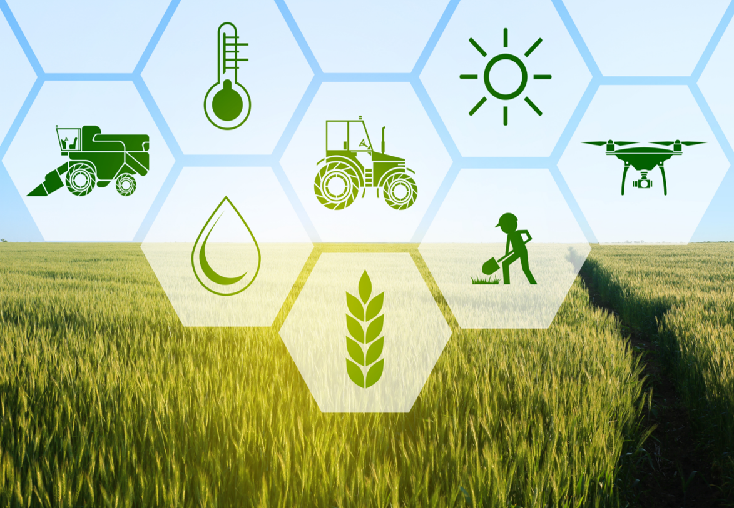

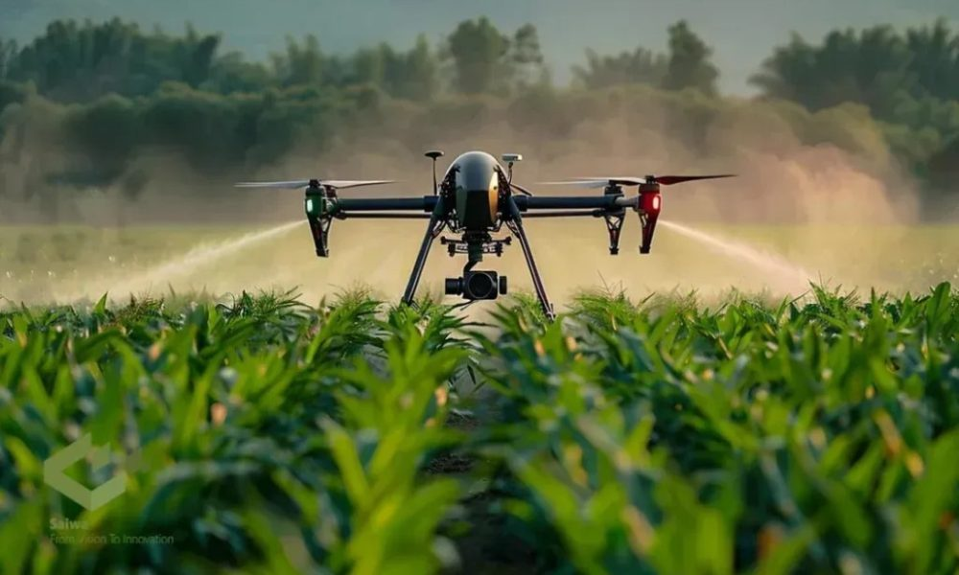

Use of IOT in Smart Agriculture
Smart farming uses IoT, sensors, and data to check crops, soil, and weather.
It helps farmers water plants properly, use fewer chemicals, and grow more food.
This way, farming becomes easier, better, and more environmentally friendly.

Slide 9



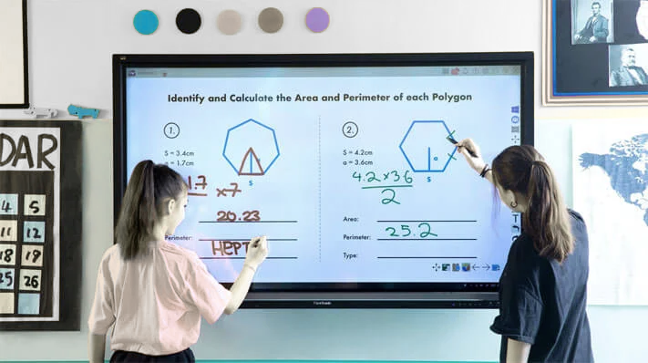
Use of IOT for Smart Education
E-learning and smart tools are changing classrooms. They make learning more fun and easy to understand. They can also take attendance automatically, saving time and making schools more efficient.

Slide 10
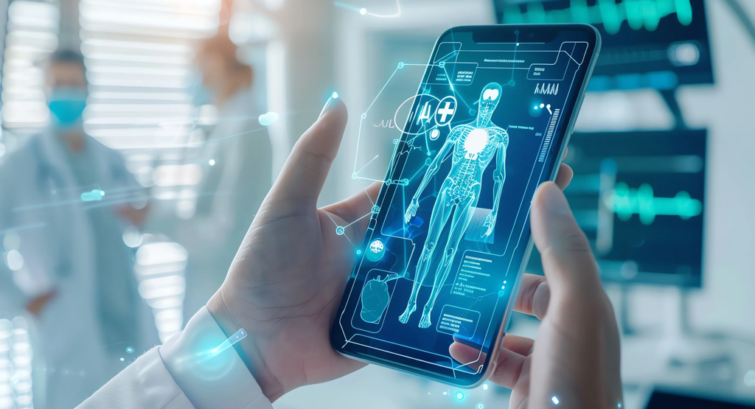
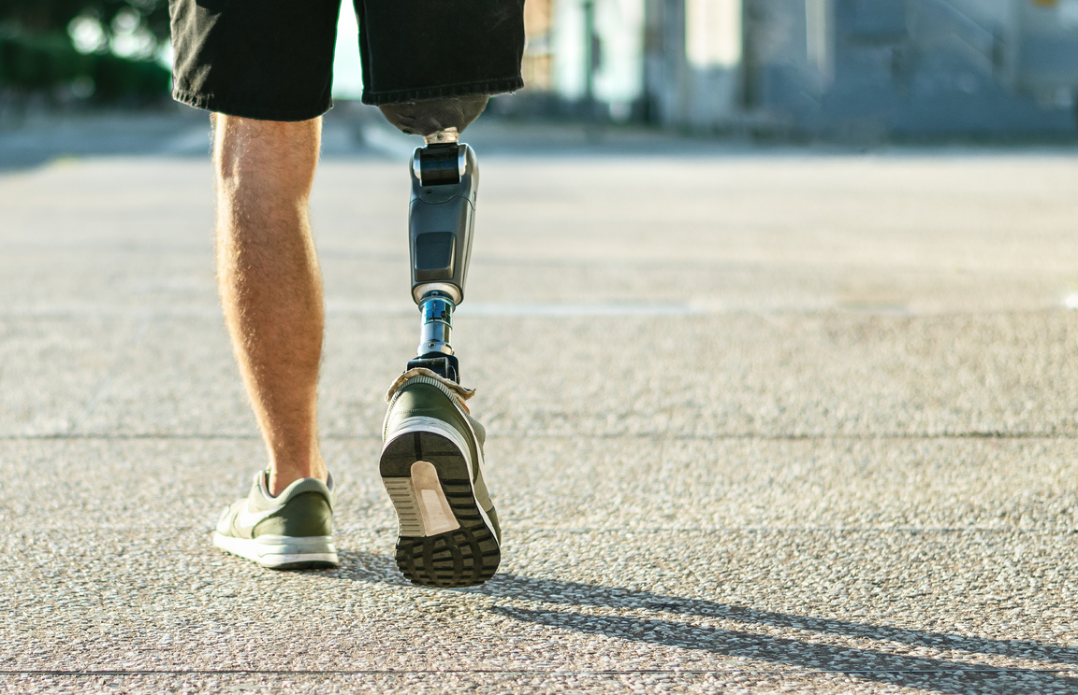


Healthcare solution With IOT
Smart healthcare uses IoT to take better care of patients. It helps doctors check patients remotely through telemedicine.
It also makes hospital work faster and more organized. This way, patients get better treatment and hospitals run more smoothly.
Smart healthcare uses sensors and digital tools to monitor patients in real time. These technologies help doctors respond quickly and provide more accurate treatments.

Slide 11
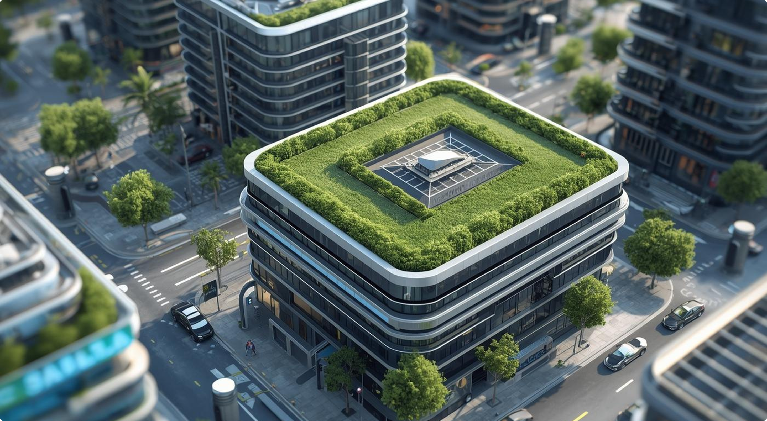

Use of IOT in Smart Environment
Smart cities use new technologies to make city life better and cleaner. They help manage resources like water, energy, and waste in a smart way. This keeps the environment healthy and makes cities more sitable for everyone.
Air Quality Monitoring with IOT
Water Management with IOT
Waste Management with IOT

Slide 12
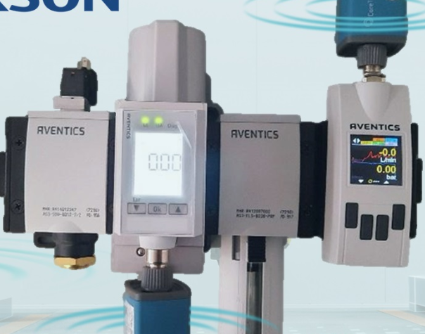
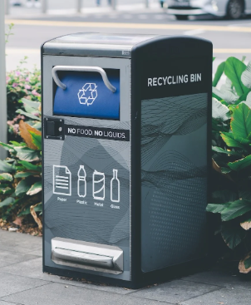

IOT For Smart Environment
Air Purification With IOT
Use of IOT for Waste
Management
Use of IOT for Water Management
Using air quality sensors in cities helps track pollution in real time, allowing quick action to protect the environment and public health.
Smart bins with IoT sensors track waste in real time, helping optimize collection, cut costs, and keep the environment clean.
IoT systems improve water management by enabling smart irrigation, monitoring, and efficient distribution.

Slide 13
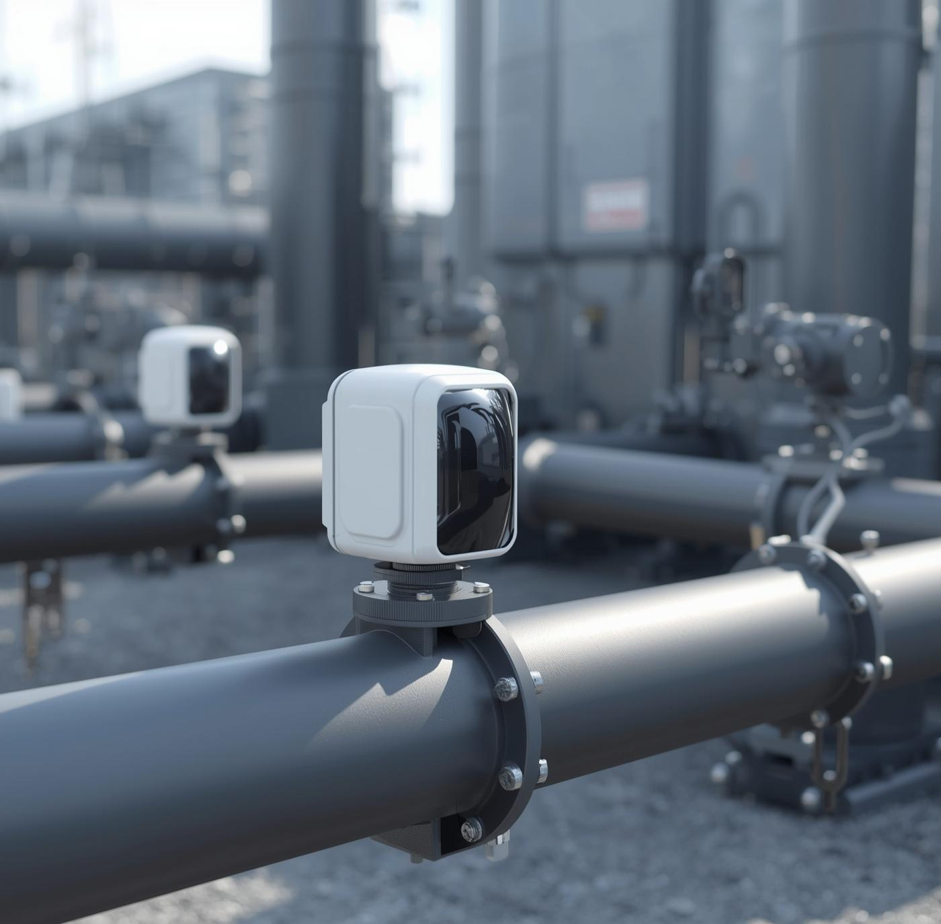
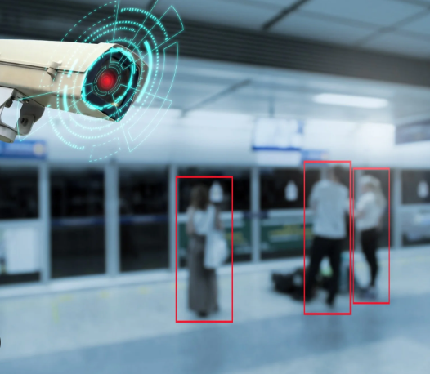

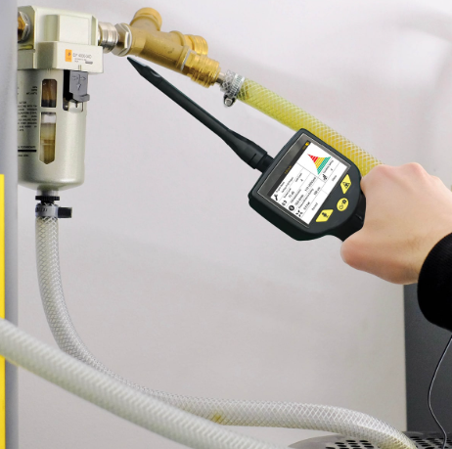
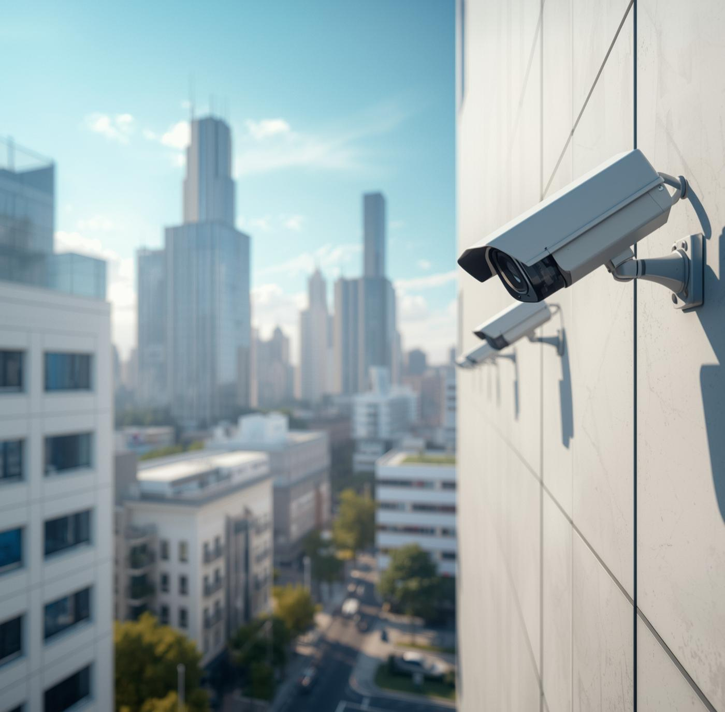
IOT Applications in Gas and Water Leak Detection
IoT devices can detect gas and water leaks quickly. Sensors monitor pipes and gas lines in real time. If a leak happens, the system sends instant alerts to prevent accidents and save resources. This helps keep homes and buildings safe and reduces waste.
Use of IOT for Public Safety
IoT makes cities safer by using sensors and cameras to detect accidents, crimes, or unusual activities.It sends instant alerts to authorities, helping prevent incidents and protect people quickly.
page 06

Slide 14
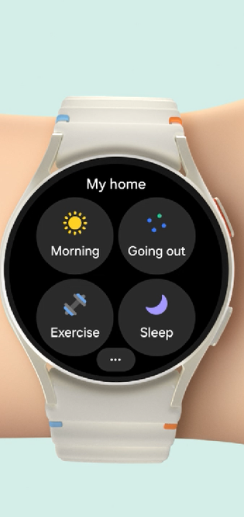

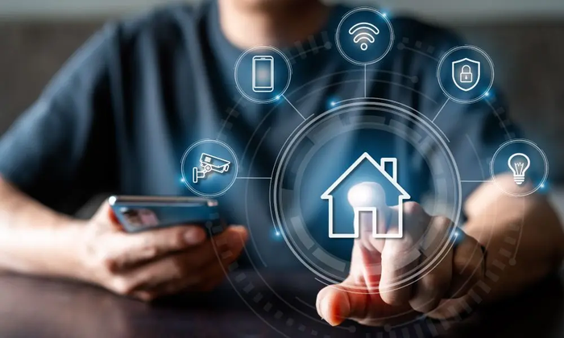
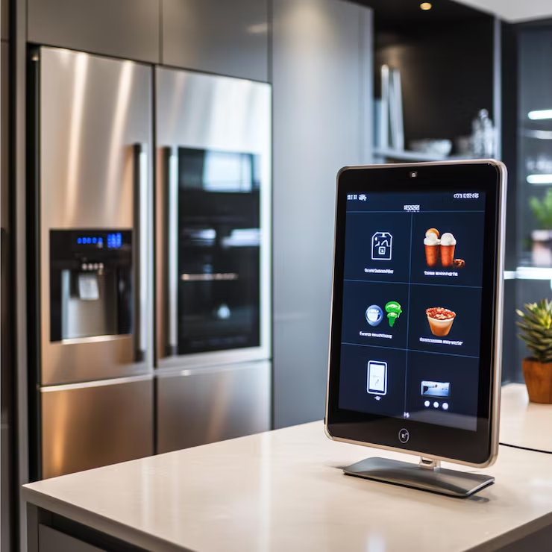

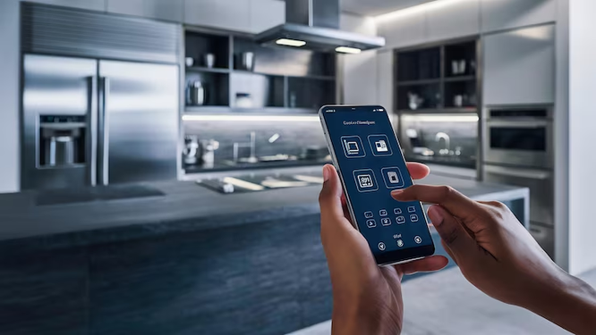
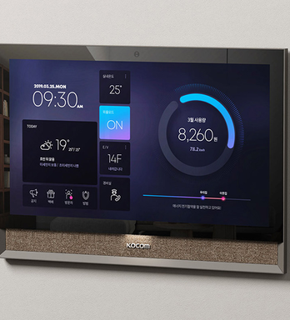

Use of IOT in Smart Buildings
Smart buildings and home use connected appliances and systems to save energy, enhance security, and manage resources efficiently.

Slide 15
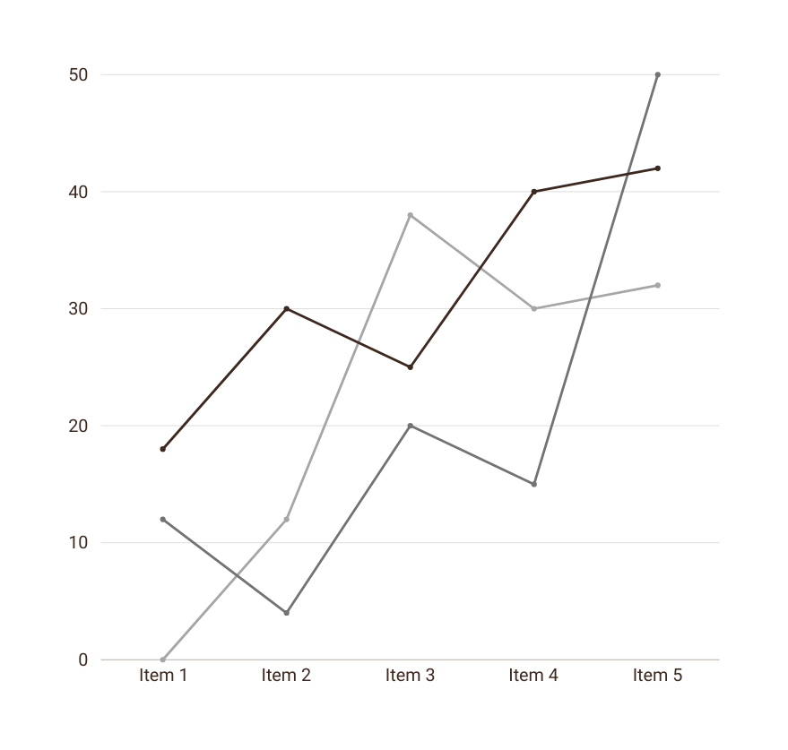
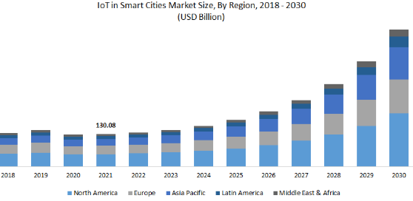
Conclusion
IOT Benefits in Smart Cities
Enhancing Urban Living
IoT has made life easier by enabling smart homes and remote control of devices.
It improves healthcare, traffic, water, and energy management for faster and better services.
Overall, IoT saves time, effort, and makes daily life smarter and safer.

Slide 16


